Slide 1
Introduction to JavaScript
Faheem Ahmed

Slide 2
JavaScript
JavaScript is a scripting language that allows building dynamic Web pages by ensuring maximum user interactivity.
JavaScript language is an object-based language, which means that it provides objects for specifying functionalities.
In a scripting language, an object has a unique identity, state, and behavior.
The object stores its identity and state in fields (also called variables) and exposes its behavior through functions (actions).
Notes:
In real life, an object is a visible entity such as a car or a table having some characteristics and capable of performing certain actions.

Slide 3

JavaScript
State
Name, Model, Color
Behavior
Start(), accelerate() Identity
Registration #
Real World Object:

Slide 4
Scripting
Scripting refers to a series of commands that are interpreted and executed sequentially and immediately on occurrence of an event.
This event is an action generated by a user while interacting with a Web page.
A scripting language refers to a set of instructions that provides some functionality when the user interacts with a Web page.
Scripting languages are often embedded in the HTML pages to change the behavior of the Web pages according to the user’s requirements.

Slide 5
Scripting
Scripting
Client-side Scripting
Server-side Scripting
Notes:
Client side:
Refers to a script being executed on the client’s machine by the browser.
Server side:
Refers to a script being executed on a Web server to generate dynamic HTML pages.

Slide 6
Client-Side JavaScript
A Client-side JavaScript is executed by the browser on the user’s machine.
A client-side script might contain instructions for the browser to handle user interactivity.
These instructions might be to change the look or content of the Web page based on the user inputs.
Examples include displaying a welcome page with the user name, displaying date and time, validating that the required user details are filled, and so on.

Slide 7
Client-Side JavaScript
Following figure displays the output of a Client-Side JavaScript:

Slide 8
Server-Side JavaScript
A Server-side JavaScript is executed by the Web server when an HTML page is requested by a user and the output is displayed by the browser.
A server-side JavaScript can interact with the database, fetch the required information specific to the user, and display it to the user.
Server-side scripting fulfills the goal of providing dynamic content in Web pages.

Slide 9
Server-Side JavaScript
Following figure displays the output of a Server-Side JavaScript:

Slide 10
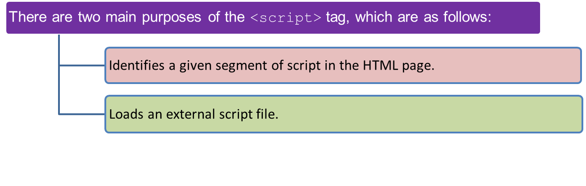
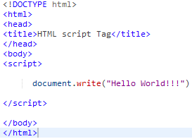

<script> tag
The HTML <script> tag is used for declaring a script (such as JavaScript) within your HTML document.
The <script> tag defines a script for an HTML page to make them interactive.
Output

Slide 11
JavaScript Variables
Variables can be thought of as named containers. You can place data into these containers and then refer to the data simply by naming the container.
Before you use a variable in a JavaScript program, you must declare it. Variables are declared with the var keyword.
Syntax:
^{where,}
var: Is the keyword in JavaScript.
variableName: Is a valid variable name.
^{var <variableName>;}

Slide 12
Declaring Variables 1-4
Declaring a variable refers to creating a variable by specifying the variable name.
For example, one can create a variable named to store the name of a student.
In JavaScript,
the var keyword is used to create a variable by allocating memory to it.
a keyword is a reserved word that holds a special meaning.
the variable can be initialized at the time of creating the variable or later.
initialization refers to the task of assigning a value to a variable.
once the variable is initialized, you can change the value of a variable as required.
variables allow keeping track of data during the execution of the script.
while referring to a variable, you are referring to the value of that variable.
one can declare and initialize multiple variables in a single statement.

Slide 13
JavaScript Variables
The Code Snippet declares two variables namely, stdID and stdName and assign values to them.
^{var stdID;}
^{var stdName;}
^{stdID = 50;}
^{stdName = “David Fernando”;}
The Code Snippet demonstrates how to declare and initialize multiple variables in a single statement in JavaScript:
^{var stdName = David,} ^{stdAge = 15;}

Slide 14
Variable Naming Rules
JavaScript is a case-sensitive language.
The variables X and x are treated as two different variables.
JavaScript consists of certain rules for naming a variable as follows:
In JavaScript, a variable name
can consist of digits, underscore, and alphabets.
must begin with a letter or the underscore character.
cannot begin with a number and cannot contain any punctuation marks.
cannot contain any kind of special characters such as +, *, %, and so on.
cannot contain spaces.
cannot be a JavaScript keyword.

Slide 15
Data Types in JavaScript 1-3
To identify the type of data that can be stored in a variable, JavaScript provides different data types.
Data types in JavaScript are classified into two broad categories namely, primitive and composite data types.
Primitive data types contain only a single value, whereas the composite data types contain a group of values.
PRIMITIVE DATA TYPES
A primitive data type contains a single literal value such as a number or a string.
A literal is a static value that you can assign to variables.

Slide 16
Data Types in JavaScript 2-3
^{Following} table lists the primitive data types.
^{Primitive Data Type} | ^{Description}
^{boolean} | Contains only two values namely, true or false
^{null} | Contains only one value namely, null. A variable of this value specifies that the variable has no value. This null value is a keyword and it is not the same as the value, zero
^{number} | Contains positive and negative numbers and numbers with decimal point. Some of the valid examples include 6, 7.5, -8, 7.5e-3, and so on
^{string} | Contains alphanumeric characters in single or double quotation marks. The single quotes is used to represent a string, which itself consists of quotation marks. A set of quotes without any characters within it is known as the null string

Slide 17
Data Types in JavaScript 3-3
COMPOSITE DATA TYPES
A composite data type stores a collection of multiple related values, unlike primitive data types.
In JavaScript, all composite data types are treated as objects.
A composite data type can be either predefined or user-defined in JavaScript.
Following table lists the composite data types.
^{Composite Data Type} | ^{Description}
^{Objects} | Refers to a collection of properties and functions. Properties specify the characteristics and functions determine the behavior of a JavaScript object
^{Functions} | Refers to a collection of statements, which are instructions to achieve a specific task
^{Arrays} | Refers to a collection of values stored in adjacent memory locations

Slide 18
Data Types in JavaScript
To identify the type of data that can be stored in a variable, JavaScript provides different data types.
Data types in JavaScript are classified into two broad categories:
Primitive Data types:
contain only a single value such as a number or a string.
Boolean
var x = true;
Null
var person = null;
Number
var length = 16;
String
var lastName = “xyz";

Slide 19
Data Types in JavaScript
Composite Data types:
Stores a collection of multiple related values.
In JavaScript all composite data types are treated as objects.
Objects
var x = {firstName:“abc", lastName:“xyz"};
Functions
function myFunction(){
alert("Hello World");
}
Arrays
var cars = [“Corolla", “Mercedes", "BMW"];

Slide 20
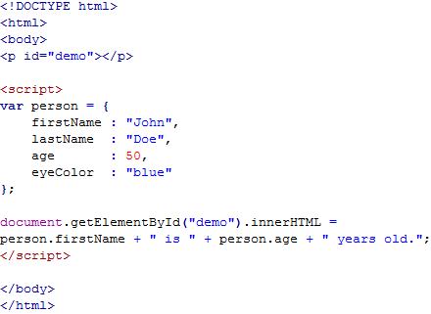

Example
Output

Slide 21
Methods 1-3
JavaScript allows you to display information using the methods of the document object.
The document object is a predefined object in JavaScript, which represents the HTML page and allows managing the page dynamically.
Each object in JavaScript consists of methods, that fulfill a specific task.
There are two methods of the document object, that display any type of data in the browser. These methods are as follows:
write(): Displays any type of data.
writeln(): Displays any type of data and appends a new line character.
The syntax demonstrates the use of document.write() method, which allows you to display information in the displayed HTML page.
^{Syntax:}
document.write(“<data>” + variables);
^{where,}
data: Specifies strings enclosed in double quotes.
variables: Specify variable names whose value should be displayed on the HTML page.

Slide 22
Methods 2-3
The syntax demonstrates the use of document.writeln() method, which appends a new line character.
^{Syntax:}
document.writeln(“<data>” + variables);
The Code Snippet demonstrates the use of write() method.
^{<!DOCTYPE HTML>}
^{<html>}
^{<head>}
<title> JavaScript language </title>
^{<script>}
document.write(“<p> JavaScript:”);
document.writeln(“is a scripting”);
document.write(“and a case-sensitive language.”);
^{</script>}
^{</head>}
^{<p>}
JavaScript: is a scripting and a case-sensitive language.
^{</p>}
^{</html>}

Slide 23
Methods 3-3
The code uses the writeln() method to display the text after the colon.
It appends a new line character after the text. Then, the text within the write() method is displayed on the same line after leaving a space.
The same paragraph is displayed in the body of the HTML page.
Note that the text in the <p> element appears on different lines.
^{In HTML, by default} the text will not be displayed in the new line in the browser even though the ENTER key is pressed while writing the code.
Rather, it will be displayed on the same line with a space. The writeln() method also follows this same format.
Following figure displays the use of write() and writeln() methods.

Slide 24
Using Comments
Comments provide information about a piece of code in the script.
When the script is executed, the browser identifies comments as they are marked with special characters and does not display them.
JavaScript supports two types of comments. These are as follows:
SINGLE LINE COMMENTS
Single-line comments begin with two forward slashes (//). You can insert single-line comments as follows:
// This statement declares a variable named num.
^{var num;}
MULTI-LINE COMMENTS
Multi-line comments begin with a forward slash followed by an asterisk (/*) and end with an asterisk followed by a forward slash (*/).
You can insert multiple lines of comments as follows:
^{/* This line of code}
^{declares a variable */}
^{var num;}

Slide 25
Escape Sequence Characters 1-2
An escape sequence character is a special character that is preceded by a backslash (\).
Escape sequence characters are used to display special non-printing characters such as a tab space, a single space, or a backspace.
In JavaScript, the escape sequence characters must be enclosed in double quotes.
Following table lists the escape sequence characters.
^{Escape Sequence} | ^{Non-Printing Character}
^{\b} | ^{Back space}
^{\f} | ^{Form feed}
^{\n} | ^{New line}
^{\r} | ^{Carriage return}
^{\t} | ^{Horizontal tab}
\’ | ^{Single quote}
\” | ^{Double quote}

Slide 26
Escape Sequence Characters 2-2
^{Escape Sequence} | ^{Non-Printing Character}
\\ | ^{Backslash}
^{\\aaa} | Matches a Latin-1 encoding character using octal representation, where aaa are three octal numbers. For example, \251 represents the copyright symbol
^{\\xaa} | Matches a Latin-1 encoding character using hexadecimal representation, where aa are two hexadecimal numbers. For example, \x61 represents the character ‘a’
^{\\uaaaa} | Represent the Unicode encoding character, where aaaa are four hexadecimal numbers. For example, the character \u0020 represents a space
The Code Snippet demonstrates the use of escape sequence characters in JavaScript.
^{<script>}
document.write(“You need to have a \u0022credit card\u0022, if
you want to shop on the \’Internet\’.”);
^{</script>}
The code uses a Unicode encoding character namely, \u0022, which represents double quotes that will contain the term credit card.
The word Internet is placed in single quotes that are specified using the backslash character.

Slide 27
Built-in Functions
A function is a piece of code that performs some operations on variables to fulfill a specific task.
It takes one or more input values, processes them and returns an output value.
Following are the built-in JavaScript functions:
alert()
confirm()
prompt()
parseInt()
parseFloat()
eval()
isNaN()

Slide 28
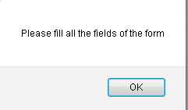

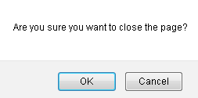

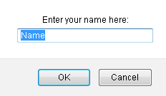

Built-in Functions
alert()
confirm()
prompt()

Slide 29
Events
An event occurs when a user interacts with the Web page.
Some of the commonly generated events are mouse clicks, key strokes, and so on.
The process of handling these events is known as event handling.
Following figure displays the event:

Slide 30
Event Handling
Event handling is a process of specifying actions to be performed when an event occurs. This is done by using an event handler.
An event handler is a scripting code or a function that defines the actions to be performed when the event is triggered.
When an event occurs, an event handler function that is associated with the specific event is invoked.

Slide 31
Event Handling
Following figure displays event handling:

Slide 32
Keyboard Events
Keyboard events are the events that occur when a key or a combination of keys are pressed or released from a keyboard.
These events occur for all keys of a keyboard.
The different keyboard events are as follows:
Onkeydown
Onkeyup
Occurs when a key is pressed down.
Occurs when a key is pressed and released.
Onkeypress
Occurs when the key is released.

Slide 33
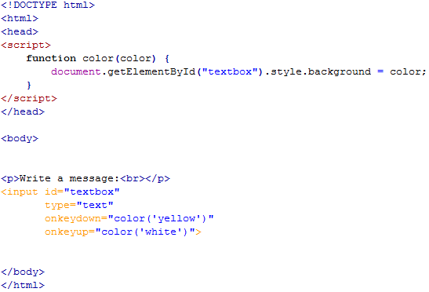

Example
Output

Slide 34
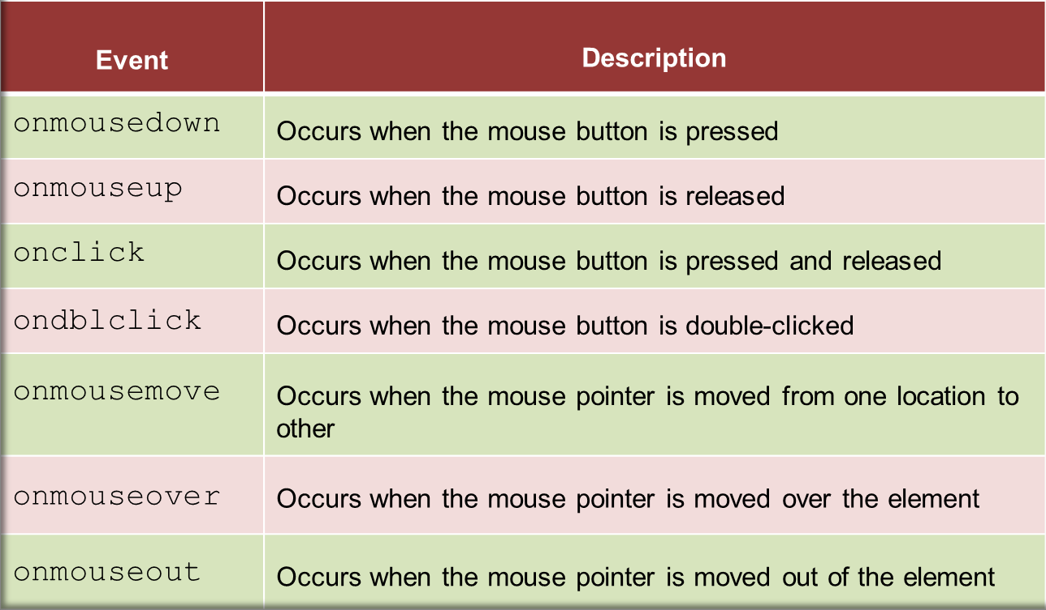
Mouse Events
Mouse events occur when the user clicks the mouse button.
Following table lists the mouse events:

Slide 35
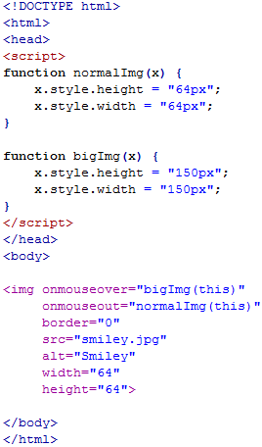


Example
Output
onmouseover
onmouseout

Slide 36
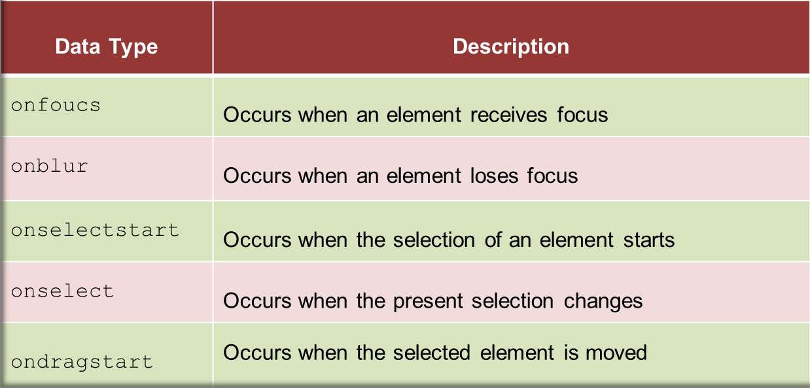
Focus & Selection Events
The focus events determine the activation of various elements that uses the element.
The selection events occur when an element or a part of an element within a Web page is selected.
Following table lists the focus and selection events:

Slide 37
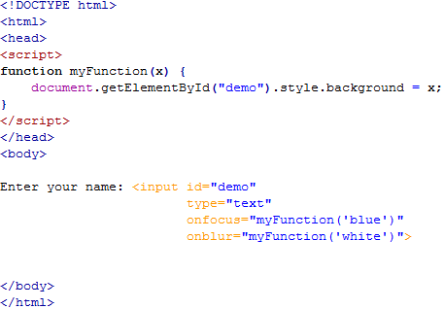

Example
Output

